Slide 1


NPI Project Management Visualization Proposal
Problem Statement
Require manual work and longer lead time for report preparation.
Unknown status of current progress from other departments.
Objective
To reduce manual work and lead time for reporting
To lead NPI project to be more visualize method of reporting.
To provide project real time progress.
Advantages
Time saving for data key in
Promote paperless concept
Provide project real time progress
Current input data/ info required
Expected Outcome
Sales Enquiry
Customer Info
DFM
PO issuance
Payment status
Moulds Fabrication Progress
Testing/ Trial schedule
Report from NPI
FAI report
Packing Method
Customer update after samples submission
Customer approval status
Others
Dashboard/ Interface than linked up all the inputs into Gantt Chart
Challenges
Gantt Chart &
Overall Progress Tracking
Need to update default setting everytime having new project
Some info still need manual key in
Resources
Stable Wifi Connection
Software programming
* Can be linked from system
* Need to update manually

Slide 2



Gantt Chart Input (Internal)
Enquiry
Project start
Pilot mould fabrication
New machine purchase
Product mould fabrication
Trial Run at JJ
Status update
Technical
Verification result
DFM
Drawing issuance
Sales
Gantt Chart
Project award status
Sales
(on behalf of customer)
Technical
(on behalf of mold maker)
Approval status
Mold fabrication progress
Mold modification status
Machine delivery status
Production
Trial schedule
Purchaser
PO issuance
Payment status
QA
FAI

Slide 3
Documents / records needed
Documented Information
NPI Project
Technical
Proposal Drawing
DFM
Quotation/ mold cost comparison
Product drawing
Mold drawing
Gantt Chart
Blue card
Improvement done
Sales
Sales Enquiry
Customer Info
Customer Approval Documents
Purchaser
Material SDS, TDS, FDA
DO
Production
Packing Format
QA
FAI
CpCpk
Others
Based on customer request

Slide 4
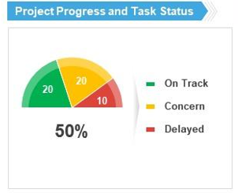
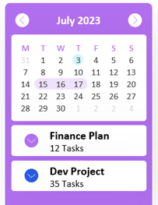
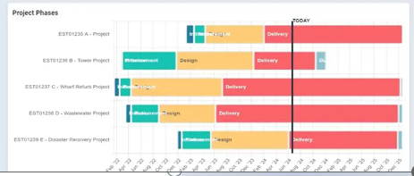
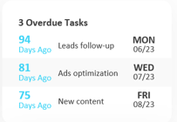
Project Management Dashboard (Draft)
YEAR
2025
Enquiry received
56
NPI Projects
6
In Progress
3
On-hold
1
Completed
2
NPI Projects List | Start Date | Completion Date | Status | Progress
Project A | 12 Jan 2025 | 8 December 2025 | Mold fabrication in progress. | 60%
Project B | 5 July 2025 | 19 November 2025 | Pending customer feedback. | 80%
Project C | 7 September 2025 | 6 January 2026 | PO issuance to mold maker. | 10%
Project D | 16 August 2025 | 11 December 2025 | Sample submission to customer. | 40%

Slide 5
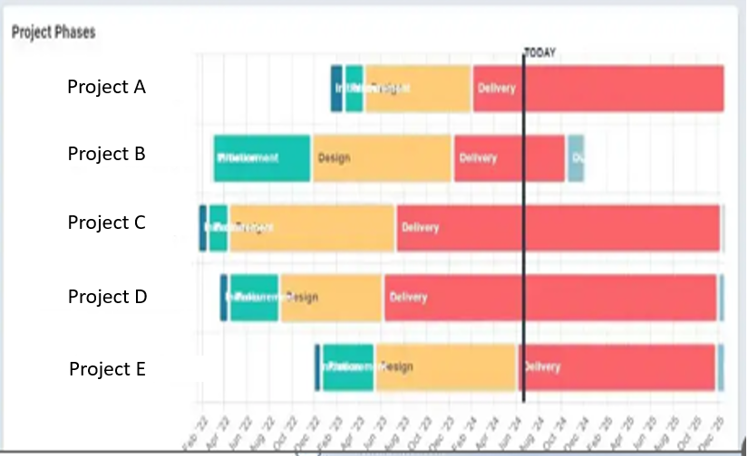
Project Management Dashboard (Draft)
YEAR
2025
Enquiry received
56
NPI Projects
6
In Progress
3
On-hold
1
Completed
2

Slide 6
Project Management Dashboard (Draft)
YEAR
2025
Enquiry received
56
NPI Projects
6
In Progress
3
On-hold
1
Completed
2

Slide 7
Enquiry received
Sales/ CS department
Fill Sales & Design Enquiry form
Notify NPI team

Slide 8
Project Management Dashboard (Draft)
YEAR
2025
Enquiry received
56
NPI Projects
6
In Progress
3
On-hold
1
Completed
2

Slide 9
NPI projects
NPI team to identify the Gantt Chart
Save in project folder
Notify selected user on overall Gantt Chart

Slide 10
Project Management Dashboard (Draft)
YEAR
2025
Enquiry received
56
NPI Projects
6
In Progress
3
On-hold
1
Completed
2

Slide 11
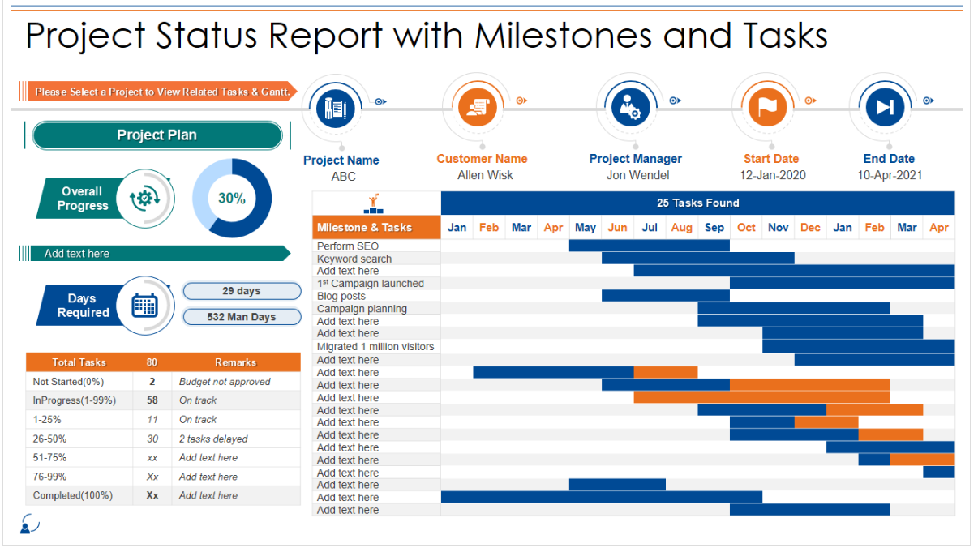

Documents
Gantt Chart
Documents upload progress

Slide 12
Documents
Gantt Chart
Documents upload progress

Slide 13
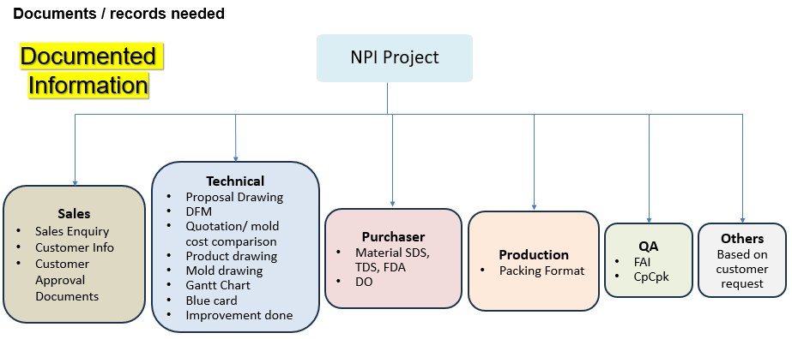

SALES
PURCHASER
TECHNICAL
QA
PRODUCTION
OTHERS

Slide 14
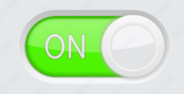
Interface of Owner (NPI team)
No | Task | PIC | Lead time | Task required? | Link? | Document format
0.1 | Sales Enquiry Form | Sales |  |  | Yes | Microsoft Forms
0.2 | Customer Info | Sales |  |  | No | Any format – manually update
0.3 | Project Awarded | Technical |  |  | No
Before launch project / notify other:
Able to add/ delete task
Or
Able to turn off not required task
Able to set PIC to upload (by enter email address)
Able to set lead time
For programmer’s reference
For those “Yes”, need to have platform/ folder to upload

Slide 15
0.0 Enquiry
Enquiry
Project start
Pilot mould fabrication
New machine purchase
Product mould fabrication
Trial Run at JJ
No | Task | PIC | Lead time | Link? | Document format
0.1 | Sales Enquiry Form | Sales |  | Yes | Microsoft Forms
0.2 | Customer Info | Sales |  | Yes | Any format – manually update
0.3 | Project Awarded | Technical |  | No | Manually status update

Slide 16
1.0 Project Start
Enquiry
Project start
Pilot mould fabrication
New machine purchase
Product mould fabrication
Trial Run at JJ
No | Task | PIC | Lead time | Link? | Document format
1.1 | Project awarded/ Contract signing | Sales |  | No | Any format – manually update
1.2 | Drawing preparation | Technical |  | Yes | STP/ PDF
1.3 | Drawing submission to customer | Sales |  | No | Manually status update
1.4 | DFM preparation | Technical |  | Yes | PDF/ PPT
1.5 | DFM submission to customer | Technical |  | No | Manually status update
1.6 | Customer drawing approval | Sales |  | Yes | PDF
1.7 | PO issuance from customer | Sales |  | No | Manually status update
1.8 | PO issuance to supplier | Purchaser |  | Yes | Purchasing System
Notes:
Link by email?
Gantt chart create any new project?

Slide 17
2.0 Pilot mould fabrication (if necessary)
Enquiry
Project start
Pilot mould fabrication
New machine purchase
Product mould fabrication
Trial Run at JJ
No | Task | PIC | Lead time | Link? | Document format
2.1 | Pilot mould fabrication | Technical |  | No | Manually status update
2.2 | Mould trial + samples shipment | Technical |  | No
2.3 | Trial sample verification | Technical |  | Yes | Excel
2.4 | Mold modification (if any) | Technical |  | No | Manually status update
2.5 | Mould trial + samples shipment | Technical |  | No
2.6 | Trial sample verification | Technical |  | Yes | Excel
2.7 | Discussion with customer | Sales |  | No | Manually status update
2.8 | Samples submission to QA | Technical |  | No
2.9 | FAI | QA |  | Yes | Excel
2.10 | Samples submission to customer | Sales |  | No | Manually status update
2.11 | Customer approval | Sales |  | Yes | PDF, Email

Slide 18
3.0 New machine purchase (if necessary)
Enquiry
Project start
Pilot mould fabrication
New machine purchase
Product mould fabrication
Trial Run at JJ
No | Task | PIC | Lead time | Link? | Document format
3.1 | Machine fabrication | Technical |  | No | Manually status update
3.2 | Packing of machine & mould | Technical |  | No
3.3 | Machine delivery | Technical |  | No
3.4 | Machine installation, test and commissioning | Technical |  | No

Slide 19
4.0 Production mould fabrication
Enquiry
Project start
Pilot mould fabrication
New machine purchase
Product mould fabrication
Trial Run at JJ
No | Task | PIC | Lead time | Link? | Document format
4.1 | MP mould fabrication | Technical |  | No | Manually status update
4.2 | Mould trial + samples shipment | Technical |  | No
4.3 | Trial sample verification | Technical |  | Yes | Excel
4.4 | Mold modification (if any) | Technical |  | No | Manually status update
4.5 | Mould trial + samples shipment | Technical |  | No
4.6 | Trial sample verification | Technical |  | Yes | Excel
4.7 | Discussion with customer | Sales |  | No | Manually status update
4.8 | Samples submission to QA | Technical |  | No
4.9 | FAI | QA |  | Yes | Excel
4.10 | Samples submission to customer | Sales |  | No | Manually status update
4.11 | Customer approval | Sales |  | Yes | PDF, Email

Slide 20
5.0 Trial run at JJ
Enquiry
Project start
Pilot mould fabrication
New machine purchase
Product mould fabrication
Trial Run at JJ
No | Task | PIC | Lead time | Link? | Document format
5.1 | Planning for trial | Production |  | Yes | Excel
5.2 | Mould trial, T0 | Production |  | No | Manually status update
5.3 | Trial sample verification | Technical |  | Yes | Excel
5.4 | Mold modification (if any) | Technical |  | No | Manually status update
5.5 | Mould trial, T1 | Technical |  | No
5.6 | Blue Card | Technical |  | Yes | Excel
5.7 | Trial sample verification | Technical |  | Yes | Excel
5.8 | FAI | QA |  | Yes | Excel
5.9 | Samples submission to customer | Sales |  | No | Manually status update
5.10 | Customer approval | Sales |  | Yes | Excel, Email, PDF

Slide 21
Documents / Records
No | Task | Responsibility PIC to upload/ update | Document format
6.1 | Sales Enquiry | Sales
6.2 | Proposal Drawing | Technical
6.3 | Functional Test Requirement (if required) | Sales/ Technical
6.4 | Mold cost comparison | Technical
6.5 | Customer approval | Sales
6.6 | Blue Card | Technical
6.7 | Packing format | Production
6.8 | FAI | QA
6.9 | Material SDS, TDS, FDA | Purchaser
6.10 | Product Drawing | Technical

